Slide 1
Lecture 9
Development Tools

Slide 2
Development tools
Since you are all still in the earlier stages of your semester-long projects, now is a good time to cover some useful modules and tools for managing larger Python projects (especially ones that involve multiple people).
virtualenv
documenting
logging
unit testing

Slide 3
Virtualenv
virtualenv is a tool for creating isolated Python environments.
Let’s say you are working on two projects which require Twisted, a python-based networking package. One of the projects requires Twisted 14.x, but the other requires Twisted 13.x. Which should you install? Solve the problem by creating a custom Python environment for each project!
To install virtualenv via pip, just open the command-line and type the following:
$ sudo pip install virtualenv
Note that all of the details in this lecture are based on Ubuntu 14.04.

Slide 4
virtualenv
To create a virtual environment for a project:
Essentially, we’re creating a copy of the Python interpreter (as well as a copy of the pip and setuptools libraries) inside of a folder called venv. We can specify a different Python version in the following way:
$ cd my_project_folder
$ virtualenv venv
$ virtualenv -p /usr/bin/python2.7 venv
Use the –no-site-packages option to not include globally installed packages.

Slide 5
virtualenv
After creating a new virtual environment, the next step is to activate it.
The name of the virtual environment will appear before your prompt after activation. Anything you install at this point will install to your isolated environment, not to the global site packages.
$ source venv/bin/activate
(venv) $
(venv) $ pip install twisted

Slide 6
virtualenv
To deactivate a virtual environment:
Now, we’re back to using the default Python interpreter and globally installed packages. You can delete a virtual environment by simply deleting the folder created, in this case called “venv”.
(venv) $ deactivate
$

Slide 7
virtualenv
For distributing your project and/or for easy set-up, freeze the current virtual environment.
This creates a list of the installed packages and versions inside of requirements.txt. This can be used to rebuild the environment later. This is useful for allowing another developer to run your project without having to figure out what packages and which versions were used.
(venv) $ pip freeze > requirements.txt

Slide 8
Virtualenv
Putting all of this together, the typical use of a virtual environment is as follows:
$ virtualenv venv –no-site-packages $ source venv/bin/activate (venv) $ pip install -r requirements.txt
…
(venv) $ deactivate

Slide 9
Virtualenv
You are encouraged to use virtual environments in your projects and to keep an updated requirements.txt with your project.
You are also encouraged to house all of your code in a repository. This makes sharing code between group members much easier. You can just pull the code and create a virtual environment with the included requirements.txt file. Easy!

Slide 10
Logging
Logging in an essential practice for non-trivial applications in which events are recorded for potential diagnostic use in the future.
Logging can be used to record the following kinds of items:
- Errors: any exceptions that are raised can be logged when they are caught.
- Significant events: for example, when an administrator logs into a system.
- Data Handled: for example, a request came into the system with x, y, z parameters.
Logging can provide useful information about the state of the program during a crash or help a developer understand why the program is exhibiting some kind of behavior.

Slide 11
Logging
The Python Standard Library actually comes with a standard logging module. It is a particularly good decision to use this module because it can include messages generated from any other package that also uses this library.
As usual, you can use the logging module by using the import logging statement.

Slide 12
logging
Here’s a simple example of some logging calls.
>>> import logging >>> logging.critical("Imminent fatal error!") CRITICAL:root:Imminent fatal error! >>> logging.error("Could not perform some function but still running.") ERROR:root:Could not perform some function but still running. >>> logging.warning("Disk space low...") WARNING:root:Disk space low...

Slide 13
Logging
There are five logging levels which should be used accordingly to reflect the severity of the event being logged.
The logging.loglevel() methods are the easiest ways to quickly log a message with a given severity level. You can also use logging.log(level, msg).
Level | Use
Debug | For development.
Info | Messages confirming expected behavior.
Warning | Warnings about future issues or benign unexpected behavior.
Error | Something unexpected happened and software is not working properly as a result.
Critical | Something unexpected happened and software is not running anymore as a result.

Slide 14
logging
Note that the info and debug messages are not logged. This is because the default logging level – the level at which messages must be logged – is warning and higher.
>>> import logging >>> logging.critical("Imminent fatal error!") CRITICAL:root:Imminent fatal error! >>> logging.error("Could not perform some function but still running.") ERROR:root:Could not perform some function but still running. >>> logging.warning("Disk space low...") WARNING:root:Disk space low... >>> logging.info("Everything seems to be working ok.") >>> loggin.debug("Here's some info that might be useful to debug with.")

Slide 15
logging
It is not typical to log directly in standard output. That might be terrifying to your client. You should at least direct logging statements to a file. Take the module logtest.py for example:
import logging logging.basicConfig(filename='example.log', level=logging.DEBUG) logging.critical("Imminent fatal error!") logging.error("Could not perform some function but still running.") logging.warning("Disk space low...") logging.info("Everything seems to be working ok.") logging.debug("Here's some info that might be useful to debug with.")

Slide 16
logging
It is not typical to log directly in standard output. That might be terrifying to your client. You should at least direct logging statements to a file. Take the module logtest.py for example:
Log debug messages and higher
import logging logging.basicConfig(filename='example.log', level=logging.DEBUG) logging.critical("Imminent fatal error!") logging.error("Could not perform some function but still running.") logging.warning("Disk space low...") logging.info("Everything seems to be working ok.") logging.debug("Here's some info that might be useful to debug with.")

Slide 17
logging
After running logtest.py, we have a logfile called example.log with the following contents:
CRITICAL:root:Imminent fatal error! ERROR:root:Could not perform some function but still running. WARNING:root:Disk space low... INFO:root:Everything seems to be working ok. DEBUG:root:Here's some info that might be useful to debug with.

Slide 18
logging
import logging import sys for arg in sys.argv: if arg[:11] == "--loglevel=": loglvl = arg[11:].upper() else: loglvl = "INFO" logging.basicConfig(filename='example.log', level=getattr(logging, loglvl)) logging.critical("Imminent fatal error!") logging.error("Could not perform some function but still running.") logging.warning("Disk space low...") logging.info("Everything seems to be working ok.") logging.debug("Here's some info that might be useful to debug with.")
An even better approach would be to allow the loglevel to be set as an argument to the program itself.

Slide 19
logging
Now, I can specify what the logging level should be without changing the code – this is a more desirable scenario. If I do not set the logging level, it will default to INFO.
~$ python logtest.py --loglevel=warning ~$ more example.log CRITICAL:root:Imminent fatal error! ERROR:root:Could not perform some function but still running. WARNING:root:Disk space low...

Slide 20
logging
The logging.basicConfig() function is the simplest way to do basic global configuration for the logging system.
Any calls to info(), debug(), etc will call basicConfig() if it has not been called already. Any subsequent calls to basicConfig() have no effect.
Argument | Effect
filename | File to which logged messages are written.
filemode | Mode to open the filename with. Defaults to ‘a’ (append).
format | Format string for the messages.
datefmt | Format string for the timestamps.
level | Log level messages and higher.
stream | For StreamHandler objects.

Slide 21
Logging
If your application contains multiple modules, you can still share a single log file. Let’s say we have a module driver.py which uses another module mymath.py.
import logging import mymath def main(): logging.basicConfig(filename='example.log', level=logging.DEBUG) logging.info("Starting.") x = mymath.add(2, 3) logging.info("Finished with result " + str(x)) if __name__ == "__main__": main()

Slide 22
logging
The mymath.py module also logs some message but note that we do not have to reconfigure the logging module. All the messages will log to the same file.
import logging def add(num1, num2): logging.debug("num1 is " + str(num1) + " and num2 is " + str(num2)) logging.info("Adding.") return num1 + num2
Note the logging of variable data here.

Slide 23
logging
This behavior gives us some insight into the reason why additional calls basicConfig() have no effect. The first basicConfig() call made during the execution of the application is used to direct logging for all modules involved – even if they have their own basicConfig() calls.
~$ python driver.py ~$ more example.log INFO:root:Starting.
DEBUG:root:num1 is 2 and num2 is 3
INFO:root:Adding.
INFO:root:Finished with result 5

Slide 24
logging
You can modify the format of the message string as well. Typically, it’s useful to include the level, timestamp, and message content.
import logging logging.basicConfig(filename='example.log', level=logging.DEBUG, format='%(asctime)s:%(levelname)s:%(message)s') logging.info("Some important event just happened.")
~? python logtest.py ~? more example.log 2015-6-11 11:41:42,612:INFO:Some important event just happened.

Slide 25
logging
All of the various formatting options can be found here.
This is really just a very basic usage of the logging module, but its definitely enough to log a small project.
Advanced logging features give you a lot more control over when and how things are logged – most notably, you could implement a rotating series of log files rather than one very large logfile which might be difficult to search through.

Slide 26
Automated testing
Obviously, after you write some code, you need to make sure it works. There are pretty much three ways to do this, as pointed out by Ned Batchelder:
Automatically test your code.
Manually test your code.
Just ship it and wait for clients to complain about your code.
The last is…just not a good idea. The second can be downright infeasible for a large project. That leaves us with automated testing.

Slide 27
testing
Let’s say we have the following module with two simple functions.
even.py
def even(num): if abs(num)%2 == 0: return True return False def pos_even(num): if even(num): if num < 0: return False return True return False

Slide 28
testing
The simplest way to test is to simply pop open the interpreter and try it out.
even.py
>>> import even >>> even.even(2) True >>> even.even(3) False >>> even.pos_even(2) True >>> even.pos_even(3) False >>> even.pos_even(-2) False >>> even.pos_even(-3) False
def even(num): if abs(num)%2 == 0: return True return False def pos_even(num): if even(num): if num < 0: return False return True return False

Slide 29
testing
This method is time-consuming and not repeatable. We’ll have to redo these steps manually anytime we make changes to the code.
even.py
>>> import even >>> even.even(2) True >>> even.even(3) False >>> even.pos_even(2) True >>> even.pos_even(3) False >>> even.pos_even(-2) False >>> even.pos_even(-3) False
def even(num): if abs(num)%2 == 0: return True return False def pos_even(num): if even(num): if num < 0: return False return True return False

Slide 30
testing
We can store the testing statements inside of a module and run them anytime we want to test. But this requires us to manually “check” the correctness of the results.
even.py
test_even.py
def even(num): if abs(num)%2 == 0: return True return False def pos_even(num): if even(num): if num < 0: return False return True return False
import even print "even.even(2) = ", even.even(2) print "even.even(3) = ", even.even(3) print "even.pos_even(2) = ", even.pos_even(2) print "even.pos_even(3) = ", even.pos_even(3) print "even.pos_even(-2) = ", even.pos_even(-2) print "even.pos_even(-3) = ", even.pos_even(-3)

Slide 31
testing
We can store the testing statements inside of a module and run them anytime we want to test. But this requires us to manually “check” the correctness of the results.
even.py
def even(num): if abs(num)%2 == 0: return True return False def pos_even(num): if even(num): if num < 0: return False return True return False
$ python test_even.py even.even(2) = True even.even(3) = False even.pos_even(2) = True even.pos_even(3) = False even.pos_even(-2) = False even.pos_even(-3) = False

Slide 32
testing
Let’s use assert statements to our advantage. Now, when we test, we only need to see if there were any AssertionError exceptions raised. No output means all tests passed!
even.py
test_even.py
def even(num): if abs(num)%2 == 0: return True return False def pos_even(num): if even(num): if num < 0: return False return True return False
import even assert even.even(2) == True assert even.even(3) == False assert even.pos_even(2) == True assert even.pos_even(3) == False assert even.pos_even(-2) == False assert even.pos_even(-3) == False

Slide 33
testing
Let’s use assert statements to our advantage. Now, when we test, we only need to see if there were any AssertionError exceptions raised. No output means all tests passed!
even.py
def even(num): if abs(num)%2 == 0: return True return False def pos_even(num): if even(num): if num < 0: return False return True return False
$ python test_even.py $
However, one error will halt our testing program entirely so we can only pick up one error at a time. We could nest assertions into try/except statements but now we’re starting to do a lot of work for testing. There must be a better way!

Slide 34
unittest
The unittest module in the Standard Library is a framework for writing unit tests, which specifically test a small piece of code in isolation from the rest of the codebase.
Test-driven development is advantageous for the following reasons:
Encourages modular design.
Easier to cover every code path.
The actual process of testing is less time-consuming.

Slide 35
unittest
Here’s an example of the simplest usage of unittest.
test_even.py
even.py
import unittest import even class EvenTest(unittest.TestCase): def test_is_two_even(self): assert even.even(2) == True if __name__ == "__main__": unittest.main()
def even(num): if abs(num)%2 == 0: return True return False
$ python test_even.py
.
-----------------------------
Ran 1 test in 0.000s
OK

Slide 36
unittest
Here’s an example of the simplest usage of unittest.
test_even.py
even.py
import unittest import even class EvenTest(unittest.TestCase): def test_is_two_even(self): assert even.even(2) == True if __name__ == "__main__": unittest.main()
def even(num): if abs(num)%2 == 0: return True return False
$ python test_even.py
.
-----------------------------
Ran 1 test in 0.000s
OK
All tests are defined in methods (which must start with “test_”) of some custom class that derives from unittest.TestCase.

Slide 37
Unittest behind the scenes
By calling unittest.main() when we run the module, we are giving control to the unittest module. It will create a new instance of EvenTest for every test method we have so that they can be performed in isolation.
test_even.py
What unittest does:
import unittest import even class EvenTest(unittest.TestCase): def test_is_two_even(self): assert even.even(2) == True if __name__ == "__main__": unittest.main()
testcase = EvenTest() try: testcase.test_is_two_even() except AssertionError: [record failure] else: [record success]

Slide 38
unittest
test_even.py
even.py
import unittest import even class EvenTest(unittest.TestCase): def test_is_two_even(self): self.assertTrue(even.even(2)) def test_two_positive(self): self.assertTrue(even.pos_even(2)) if __name__ == '__main__': unittest.main()
def even(num): if abs(num)%2 == 0: return True return False def pos_even(num): if even(num): if num > 0: return False return True return False
We’ve added some new tests along with some new source code. A couple things to notice: our source code has a logical error in it and we’re no longer manually asserting. We’re using unittest’s nice assert methods.

Slide 39
unittest
$ python test_even.py .F ======================================================== FAIL: test_two_positive (__main__.EvenTest) -------------------------------------------------------- Traceback (most recent call last): File "test_even.py", line 8, in test_two_positive self.assertTrue(even.pos_even(2)) AssertionError: False is not true -------------------------------------------------------- Ran 2 tests in 0.000s FAILED (failures=1)
Extra information given to us by unittest’s special assertion method.

Slide 40
unittest
The unittest module defines a ton of assertion methods:
assertEqual(f, s)
assertNotEqual(f,s)
assertIn(f, s)
assertIs(f,s)
assertGreater(f, s)
assertRaises(exc, f, …)
etc.

Slide 41
unittest
test_even.py
even.py
import unittest import even class EvenTest(unittest.TestCase): def test_is_two_even(self): self.assertTrue(even.even(2)) def test_two_positive(self): self.assertTrue(even.pos_even(2)) if __name__ == '__main__': unittest.main()
def even(num): if abs(num)%2 == 0: return True return False def pos_even(num): if even(num): if num < 0: return False return True return False

Slide 42
unittest
$ python test_even.py .. ------------------------------------------- Ran 2 tests in 0.000s OK $

Slide 43
unittest
We incrementally add unit test functions and run them – when they pass, we add more code and develop the unit tests to assert correctness. Do not remove unit tests as you pass them.
Also, practice unit testing as much as you can. Do not wait until it is absolutely necessary. As with logging, there is a lot more to unit testing that we’re not covering here so definitely look up the docs and read articles about unit testing in Python to learn more about the advanced features. Ned Batchelder also has a relevant unit testing talk from PyCon ‘14. Check it out here.

Slide 44
Documentation
Being able to properly document code, especially large projects with multiple contributors, is incredibly important.
Code that is poorly-documented is sooner thrown-out than agonized over. So make sure your time is well-spent and document your code for whoever may need to see it in the future! Python, as to be expected, has a selection of unique Python-based documenting tools and as a Python developer, it is important that you be familiar with at least one of them.

Slide 45
Sphinx
The Sphinx documentation tool is by far the most popular way to document Python code and is, in fact, used to generate the official Python documentation which is notoriously thorough and well-kept. There exist some other options like Pycco, Epydoc, and MkDocs – but Sphinx truly is the standard. Getting Sphinx is super easy: $ sudo pip install sphinx

Slide 46
What is sphinx?
Introduced in 2008 for documenting Python (and is written in Python).
Converts reStructuredText to HTML, PDF, man page, etc.
reStructuredText was developed to be a lightweight markup language specifically for documenting Python.
But it’s not just Python! C/C++ also supported with more languages on the way.

Slide 47
Sphinx features
Output formats: HTML, LaTeX (for printable PDF versions), ePub, Texinfo, man pages, plain text.
Extensive cross-references: semantic markup and automatic links for functions, classes, citations, glossary terms and similar pieces of information.
Hierarchical structure: easy definition of a document tree, with automatic links to siblings, parents and children.
Automatic indices: general index as well as a language-specific module indices.
Code handling: automatic highlighting using the Pygments highlighter.
Extensions: automatic testing of code snippets, inclusion of docstrings from Python modules (API docs), and more.
Contributed extensions: 50+ extensions contributed by community – most available from PyPI.

Slide 48
Setting up SphinX
Sphinx documentation requires a variety of source files which are housed within a single source directory. The central component of the source directory is the conf.py file which configures all aspects of a Sphinx project.
The easiest way to get a Sphinx project started is to issue the following command: $ sphinx-quickstart This will guide you through generating a source directory and a default typical conf.py.

Slide 49
quickstart
ticket_app/docs$ sphinx-quickstart
Welcome to the Sphinx 1.2.3 quickstart utility.
Please enter values for the following settings (just press Enter to
accept a default value, if one is given in brackets).
Enter the root path for documentation.
> Root path for the documentation [.]:
...
Finished: An initial directory structure has been created.
You should now populate your master file ./index.rst and create other documentation source files. Use the Makefile to build the docs, like so:
make builder
where "builder" is one of the supported builders, e.g. html, latex or linkcheck.
ticket_app/docs$ ls
_build conf.py index.rst make.bat Makefile _static _templates
By default, quickstart creates a source directory with conf.py and a master document, index.rst. The main function of the master document is to serve as a welcome page, and to contain the root of the “table of contents tree” (or toctree), which connects multiple rst files into a single hierarchy.

Slide 50
Index.rst
Welcome to Ticket Scraper's documentation! ========================================== Contents: .. toctree:: :maxdepth: 2 Indices and tables ================== * :ref:`genindex` * :ref:`modindex` * :ref:`search`
Let’s take a look at the main index.rst they created for us. The toctree directive allows us to specify other .rst files to include in our documentation.

Slide 51
Index.rst
Welcome to Ticket Scraper's documentation! ========================================== Contents: .. toctree:: :maxdepth: 2 intro tech
Let’s take a look at the main index.rst they created for us. The toctree directive allows us to specify other .rst files to include in our documentation. We’ve currently added two local .rst files. These files themselves may also have toctree directives which are used to grow the tree. * Leave off the extension and use ‘/’ for directories.

Slide 52
reStructuredtext
Paragraphs: chunks of text separated by one or more blank lines. All lines of the same paragraph must be left-aligned to the same level of indentation.
Inline Markup
*emphasis* → emphasis
**strong emphasis** → emphasis
``code snippet`` -- Note the backquotes.
Escape special characters (e.g. asterisks) with a backslash.
May not be nested and content must start and end with non-whitespace.
Interpreted Text Roles → :rolename: `content`
Standard roles: emphasis, strong, literal, subscript, superscript, etc.

Slide 53
restructuredtext
Lists: just place list markup at start of paragraph and indent accordingly.
‘*’ indicated bulleted list.
‘1’, ‘2’, ‘3’, etc for manually numbered lists.
‘#’ for auto-numbered lists.
Preserve line breaks with ‘|’.
* this is * a list * with a nested list * and some subitems * and here the parent list continues

Slide 54
Restructuredtext
Code snippets are commonly included in the documentation of a project – specifically when describing use.
End the preceding paragraph with the :: marker and indent the code sample.
Remember! As in Python, whitespace is significant to Sphinx. Typically this means you’ll need to indent but sometimes directives and markers cannot be preceded by whitespace – be careful.
This is a normal text paragraph. The next paragraph is a code sample:: It is not processed in any way, except that the indentation is removed. It can span multiple lines. This is a normal text paragraph again.

Slide 55
Restructuredtext
Section headers are created by overlining and underlining the header content with some punctuation character.
The heading level of the punctuation character is determined by context, however the convention is:
# with overline, for parts.
* with overline, for chapters.
=, for sections.
-, for subsections.
^, for subsubsections.
========================== This is a Section heading ==========================

Slide 56
restructuredtext
Besides toctree, many directives are supported.
“Admonition”-elements like attention, tip, and warning, the image and figure directives, etc.
Here are the available directives.
Comments are constructed like so:
.. This is a comment. .. This whole indented block is a comment. Still in the comment.

Slide 57
Intro.rst
Now that we know more about reStructuredText, we can create intro.rst and add it to our documentation.
intro.rst
Introduction ============================== Goals ------------------------------ The goal of this documentation is to provide a clear and technologically informative basis for the structure, functionality, and design of the Taylor Swift Concert Ticket Price Showdown application.

Slide 58
Tech.rst
We can also make a simple tech.rst, which would supposedly describe the technologies used in our application.
tech.rst
Technologies ============================

Slide 59
Building sphinx
Now we have some very simple rst files to build our documentation with. Generally speaking, you can build Sphinx projects in the following way:
But we were smart enough to use Sphinx’s quickstart tool so we have a makefile.
$ sphinx-build -b html sourcedir builddir
The -b option selects the format.

Slide 60
Building sphinx
ticket_app/docs$ make html
sphinx-build -b html -d _build/doctrees . _build/html
Running Sphinx v1.2.3
loading pickled environment... done
building [html]: targets for 2 source files that are out of date
updating environment: 0 added, 2 changed, 0 removed
reading sources... [100%] tech
looking for now-outdated files... none found
pickling environment... done
checking consistency... done
preparing documents... done
writing output... [100%] tech
writing additional files... genindex search
copying static files... done
copying extra files... done
dumping search index... done
dumping object inventory... done
build succeeded.
Build finished. The HTML pages are in _build/html.
The makefile provided by the quickstart tool allows you to specify a number of targets, including:
html
json
latex
latexpdf
man
xml
etc.

Slide 61
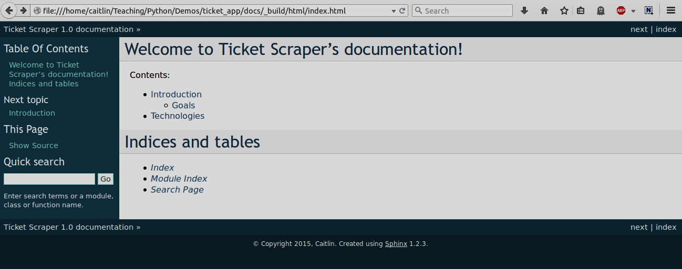
Building sphinx

Slide 62
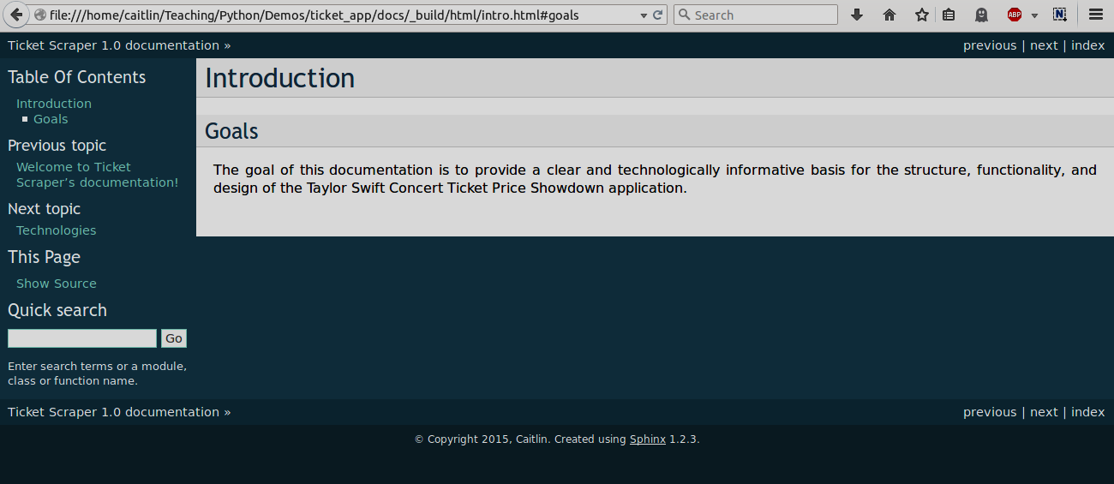
Building sphinx

Slide 63
Documenting code
The manual way to document a Python object is like this:
.. function:: get_posts(event_name, location) Accesses the Craigslist page of search results for a given event and location. Returns a list of post information tuples, sorted by price.
You can reference an object by using the :func: notation, where the object name is in backquotes.
There are also directives for classes, methods, etc. Any object can be documented.
The :func:`get_posts` function can be called...

Slide 64
Scraper.rst
Let’s add an rst file to document our scraping code.
Ticket Scraping ========================================== Ticket scraping is performed by the ticket_scraper.py module. Initial calls should be made to the :func:`get_posts` function, which will guide the scraping process and returns a list of relevant posts. .. function:: get_posts(event_name, location) Accesses the Craigslist page of search results for the given event and location. Returns a list of post information tuples, sorted by price.

Slide 65
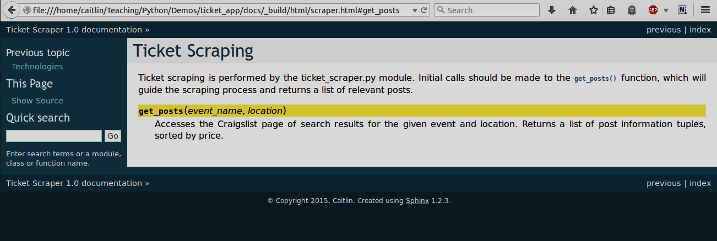
Scraper.rst

Slide 66

autodoc
The autodoc feature allows you to use your source code docstrings to generate the documentation. You can autodoc on a function basis:
Or on a module basis (and other bases, as well):
But make sure the path to your source code is available in conf.py
.. autofunction:: ticket_scraper.get_posts
.. automodule:: ticket_scraper :members:

Slide 67
autodoc
def get_posts(event_name, location): ''' The get_posts function accesses the Craigslist page of search results for the given event and location. Returns a list of post information tuples, sorted by price. :param event_name: The keyword with which to search for the event. :type event_name: String.
:param location: The area in which to search for the event. :type location: String. :returns: List of tuples of post information, sorted by price. :raises: None. ''' ev = '+'.join(event_name.split()) page = requests.get("http://" + str(location.lower()) + url + ev) tree = html.fromstring(page.text) posts_pages = get_pages(tree, location) post_info = get_post_info(posts_pages) return sorted(post_info, key=lambda post: int(post[4]))
Docstring comments can be in whichever format you choose, but there are some key structures which Sphinx will know how to render. For example:

Slide 68
The new scraper.rst
Ticket Scraping ========================================== Ticket scraping is performed by the ticket_scraper.py module. Initial calls should be made to the :func:`get_posts` function, which will guide the scraping process and returns a list of relevant posts. .. automodule:: ticket_scraper :members:
In conf.py: sys.path.insert(0, os.path.abspath(‘..’)+ “/app/”)

Slide 69
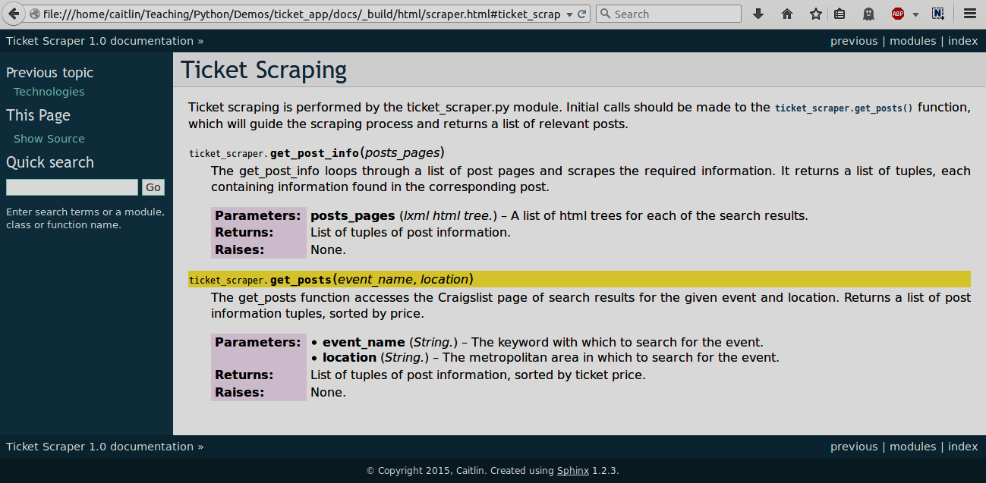
The new scraper.rst

Slide 70
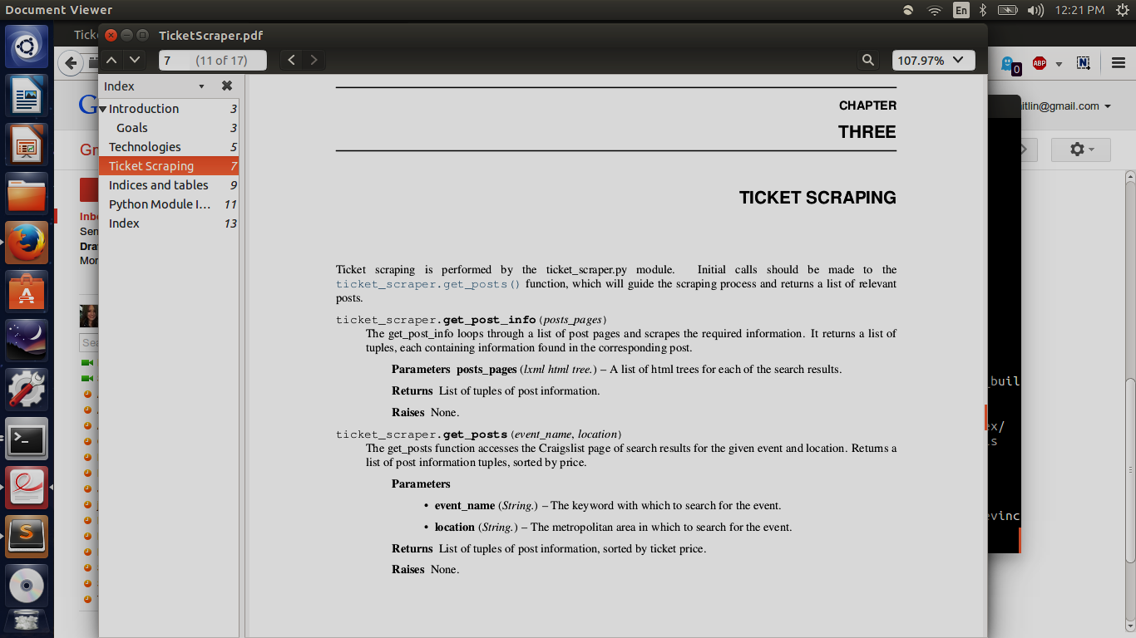
And a pdf!
For some light reading…

Slide 71
Sphinx
Matplotlib has provided a nice Sphinx tutorial, especially for mathematical modules and customizing the documentation look. Check it out here.
A list of the major projects that use Sphinx can be found here. You can check out their docs and then look for the “source” or “show source” option to see the rst that created the page.
readthedocs.org is a docs-hosting website specifically geared towards Sphinx documentation.
Bitbucket, at least, works well with rst files and you can include your Sphinx docs in your repository without worrying about readability.

